Slide 1

CTK Events
TEAM-1
G.Rajeswari
K.Pranathi Reddy
B.Sathvik Reddy
G.Santhosh Kumar

Slide 2
Project Introduction
An innovative Online Event Management Platform designed to streamline the creation, management, and attendance of events.
Bridges the gap between event organizers (admins) and attendees (users) with seamless interaction and communication.
Ensures secure login, real-time notifications, and easy booking processes to enhance user experience.
Empowers admins to efficiently create events, monitor bookings, manage feedback, and resolve queries.

Slide 3
Project Overview
Users can browse upcoming events, book tickets, provide feedback, and communicate directly with admins.
Admins have the capability to create, update, delete events, review bookings and feedback, and manage user queries.
Integrated notification system keeps all parties updated on bookings, cancellations, event changes, and responses.
Built with a modern technology stack to ensure scalability, security, and smooth performance across devices.

Slide 4
Problem Statement
Manual event management causes inefficiencies
Difficult event discovery & ticket booking for users
Lack of streamlined communication between users and admins
Inadequate feedback handling and event updates

Slide 5
Project Objectives
The CTK Event Management System is designed with the following objectives:
Simplify Event Booking → Provide users with an easy way to browse, book, and cancel events online.
Enhance User Experience → Send instant notifications and emails for confirmations, cancellations, and updates.
Empower Administrators → Enable admins to create, update, and manage events, bookings, and user queries efficiently.
Ensure Security → Protect user data and access using JWT authentication, password hashing, and role-based authorization.
Centralize Feedback → Collect and store feedback from users to help improve future events.
Scalability & Automation → Build a scalable platform that can handle growth and automate tasks like sending reminders and feedback requests.

Slide 6
Project Scope
Project Scope: CTK Event Management System
User Management: Secure registration, login, and profile management.
Event Management: Admins can create, update, delete events; users can browse event details.
Booking Management: Users can book or cancel tickets; admins track bookings.
Notifications & Communication: Real-time updates and announcements for users.
Feedback & Reporting: Users provide feedback; admins review and generate reports.
Security & Technology: Secure authentication, scalable web-based platform, and encrypted data.
Goal: Provide a centralized, efficient, and user-friendly platform for smooth event management.

Slide 7
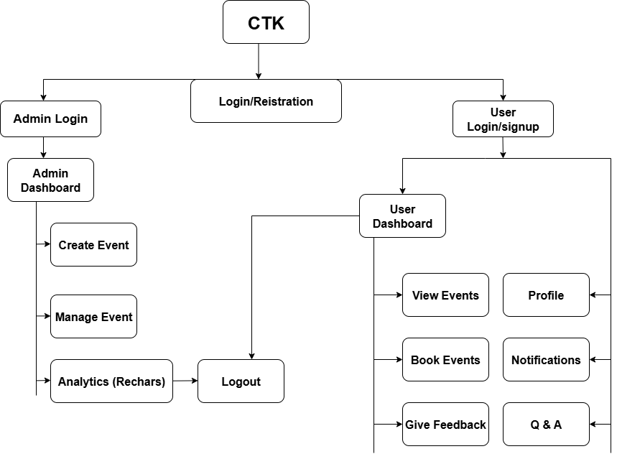
Frontend System Architecture

Slide 8
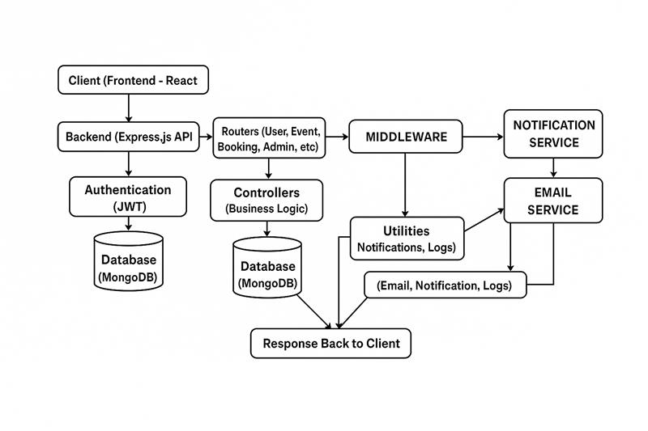
Backend System Architecture

Slide 9

Technologies Used
The CTK Event Management System is built using modern and scalable technologies:
Frontend:
React.js – For building a responsive and interactive user interface.
Recharts – For creating interactive charts and visual reports (feedback stats, booking analytics, etc.).
Backend: Node.js with Express.js – for handling API requests and managing server-side logic.

Slide 11

Technologies Used
Database: MongoDB – for storing users, events, bookings, notifications, and feedback in a flexible NoSQL structure.
Authentication & Security:
JWT (JSON Web Token): Secure user authentication.
Bcrypt.js: Password hashing and protection.

Slide 12
Technologies Used
Services & Utilities:
Nodemailer: Sending emails for OTPs, notifications, and confirmations.
Multer: Handling file uploads (event images).
Node-Cron: Automating scheduled tasks.
Other Tools:
dotenv: Environment variable management.
Winston Logger: For application logging and error tracking.
CORS: For secure communication between frontend and backend.

Slide 13
Technologies Used
.
Payment Gateway
Razorpay – Secure and reliable online payment integration for booking tickets.
CI/Cd(Continuos Integration & Continuous Deployment)
GitHub – Source code management and version control
Jenkins – Automating builds, tests, and deployment pipelines.
Docker – Containerization for consistent deployment across environments.
AWS (EC2 / S3 ) – Hosting and cloud infrastructure for deployment.

Slide 14
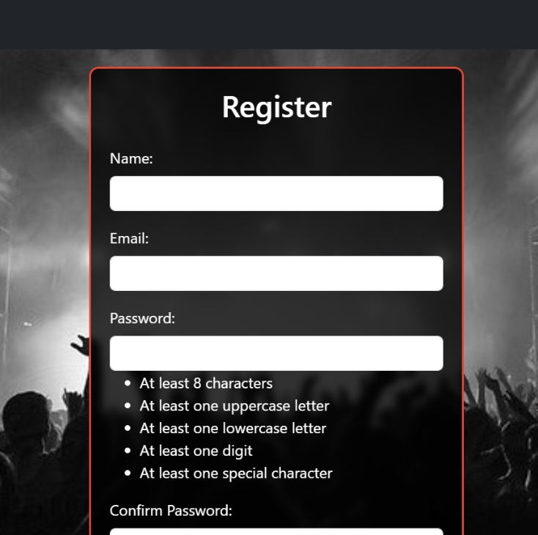
Implemetation Details
Collect User Information
Validate Input Data
Check for Duplicate Accounts
Store User Details in Database

Slide 15
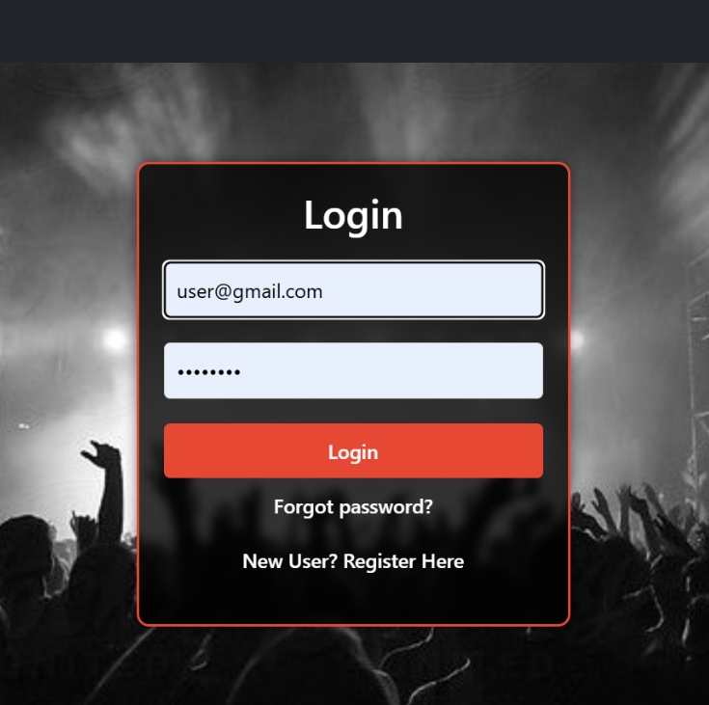
Implemetation Details
User Credentials Input
Authentication and Token Generation
Error Handling and Validation

Slide 16
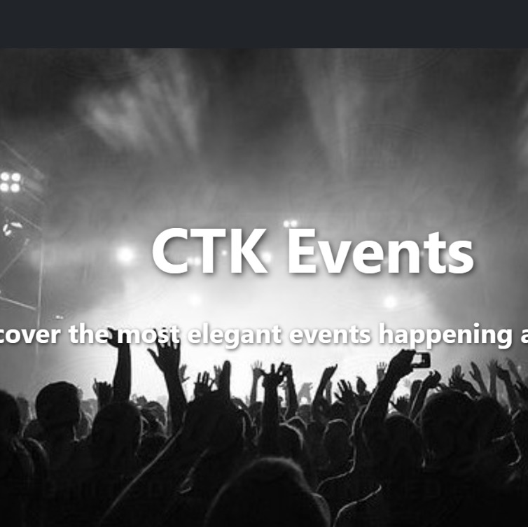
Home Page

Slide 17
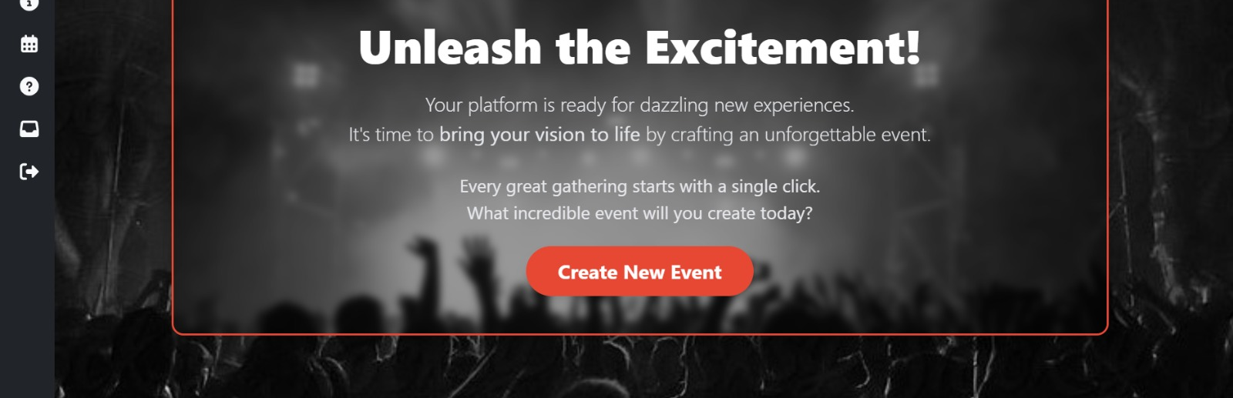
Event Creation and Management

Slide 18
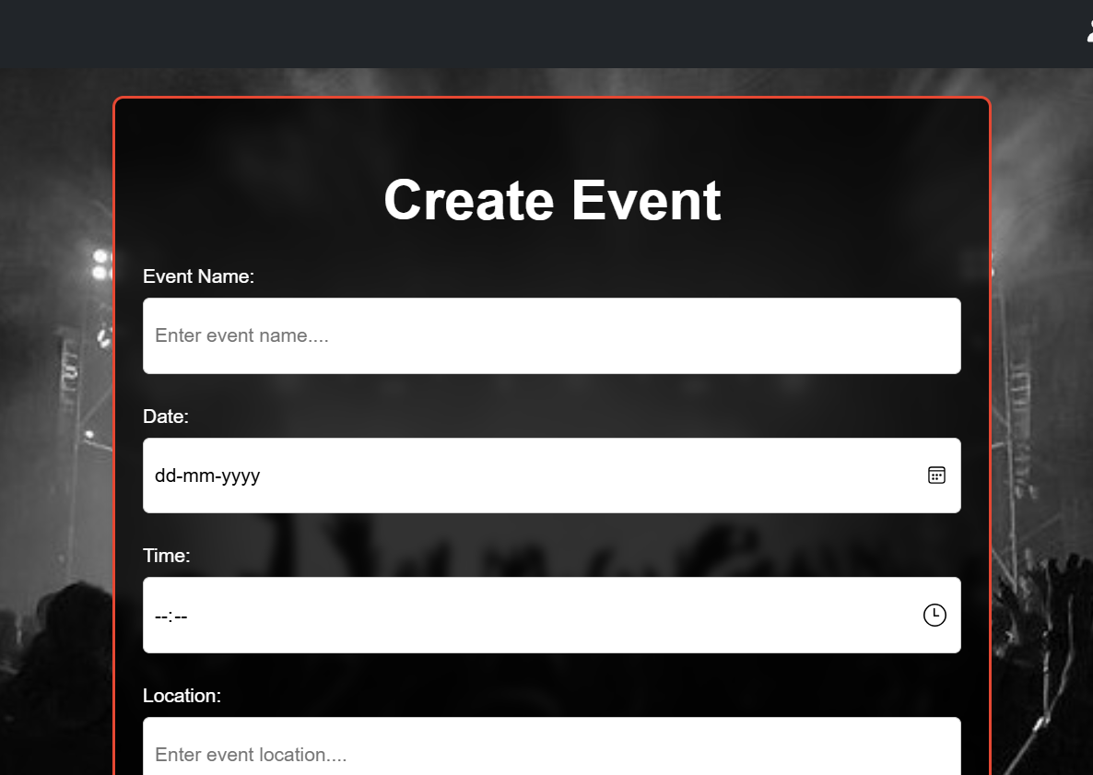
Enter Event Details
Upload Event Media
Set Booking & Pricing

Slide 19
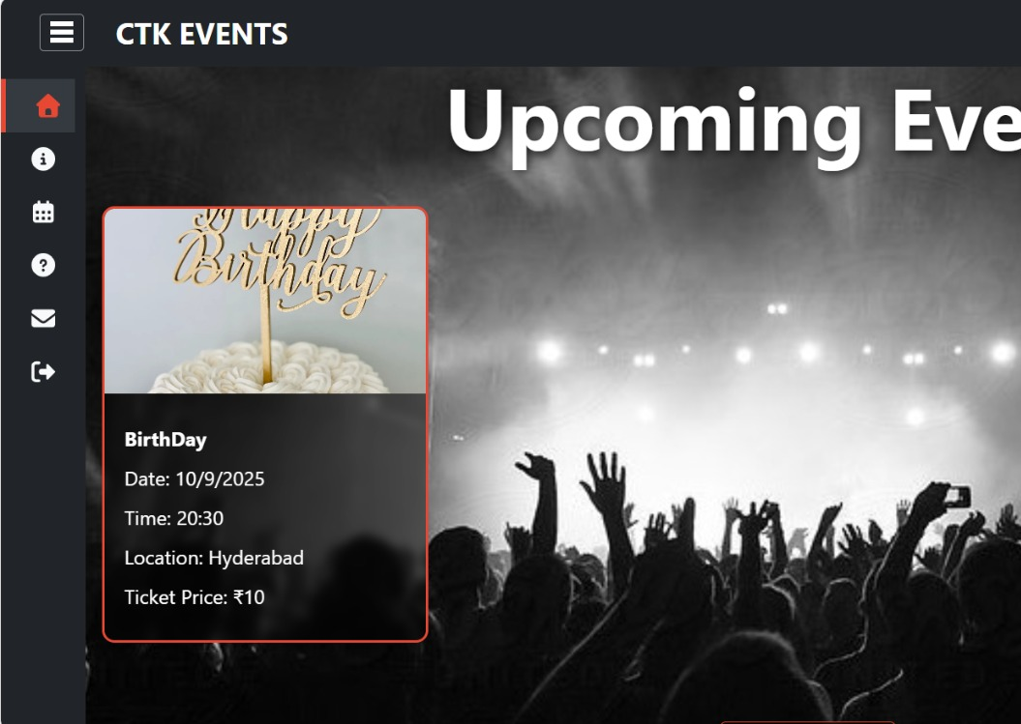
Event List Display
Event Details Preview
Filter and Search Options
Booking and Reminder Links

Slide 20
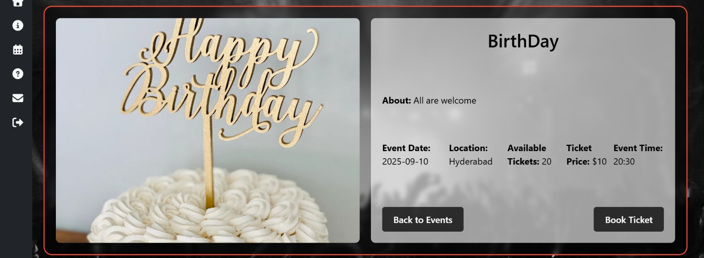
Event Selection and Details
Booking Confirmation Process

Slide 21
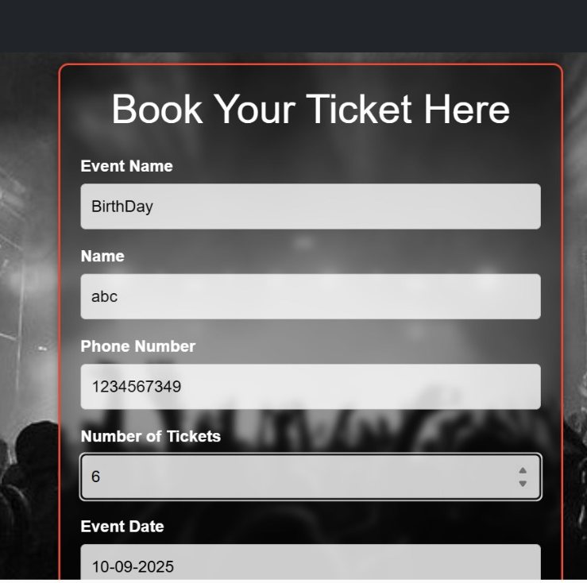
Select Event and Ticket Type
Enter Attendee Information
Confirm Booking and Payment

Slide 22
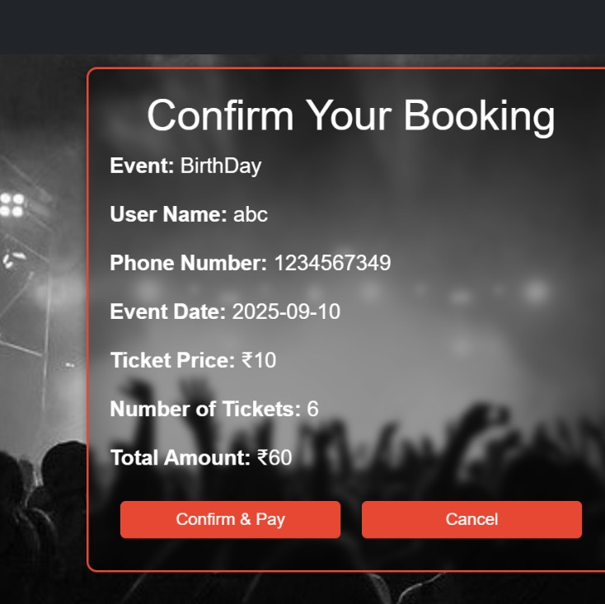
Review Booking Details
Verify Payment Information
Finalize and Submit Booking
Receive Confirmation and Ticket

Slide 23
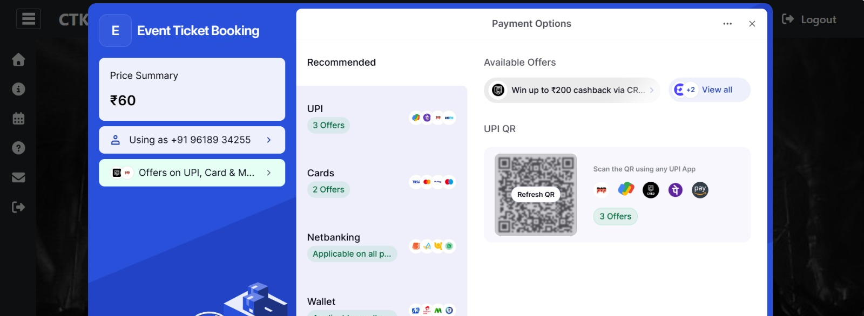
Payment Gateway Integration
Secure Transaction Processing
Handling Payment Status
Providing Payment Confirmation

Slide 24
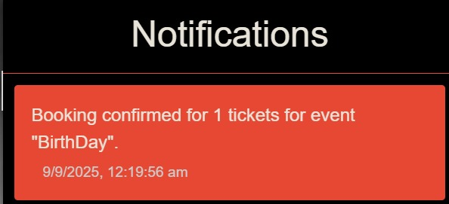
Trigger After Successful Booking
Send Confirmation Email or Message
Include Booking and Event Details

Slide 25
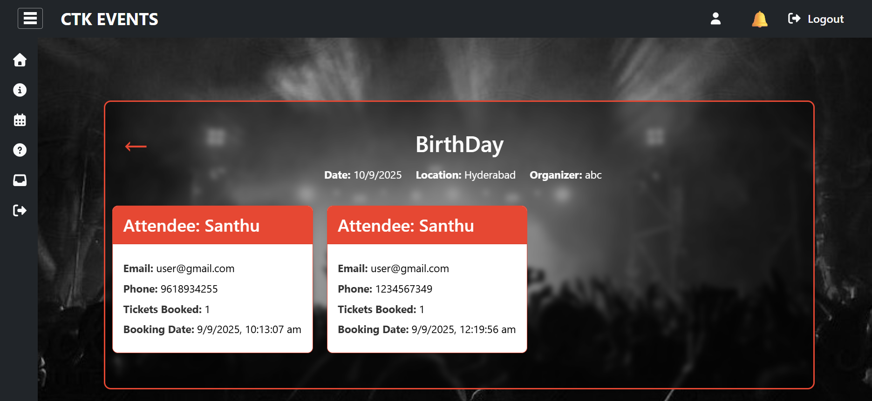

Slide 26
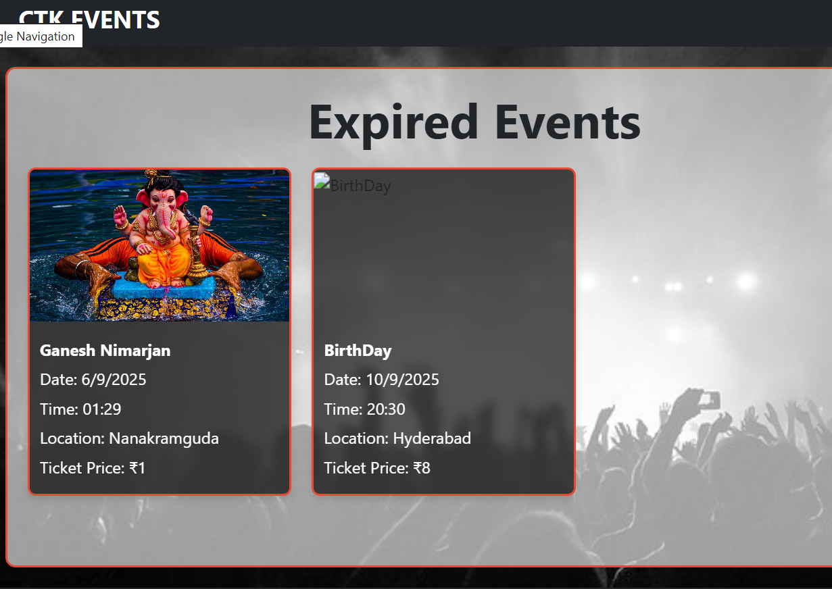
Display Past Events
Show Event Details and Summary

Slide 27
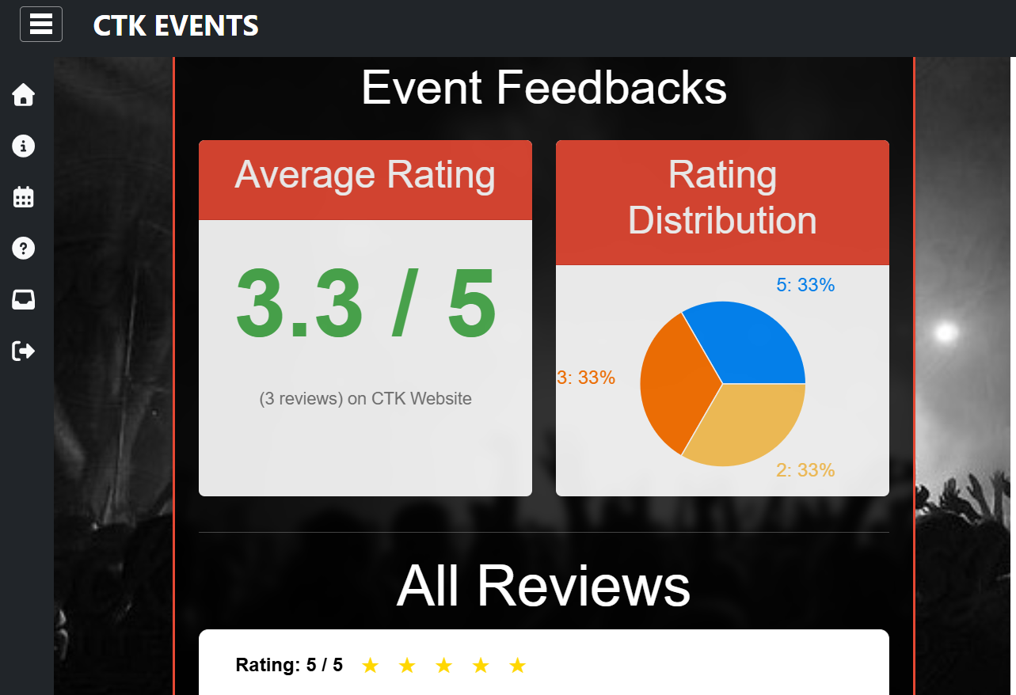
Collect User Feedback
Display Feedback Form
Store Feedback in Database

Slide 28
Future Enhancement
Two-Factor Authentication (2FA)
Currently, password reset uses OTP over email.
In the future, we can add 2FA with SMS OTP or Google Authenticator forstronger security.
Benefit: Protects users even if their email is compromised.
Event Recommendations (AI/ML)
Use machine learning to suggest events based on user’s past bookings,interests, and activity.
Benefit: Personalized experience → more engagement.
Mobile App Integration
Future plan: Develop a React Native / Flutter mobile app.
Benefit: Reach wider audience, easy booking on-the-go.
Chatbot & Customer Support
Add a chatbot for FAQs like “How to book?”, “Cancel event?”, “Paymentissue?”.
Benefit: Improves user support and reduces manual queries.

Slide 29
Conclusion
The project is designed to help users easily create, manage, and participate in events while ensuring security, smooth booking, and real-time notifications. It provides admin controls for managing users and events effectively. With features like password recovery, secure file uploads, and token validation, the system is safe and user-friendly. The project improves communication between users and event organizers and ensures data integrity, making event management more efficient.

Slide 30


Slide 31
THANK YOU

